Slide 1
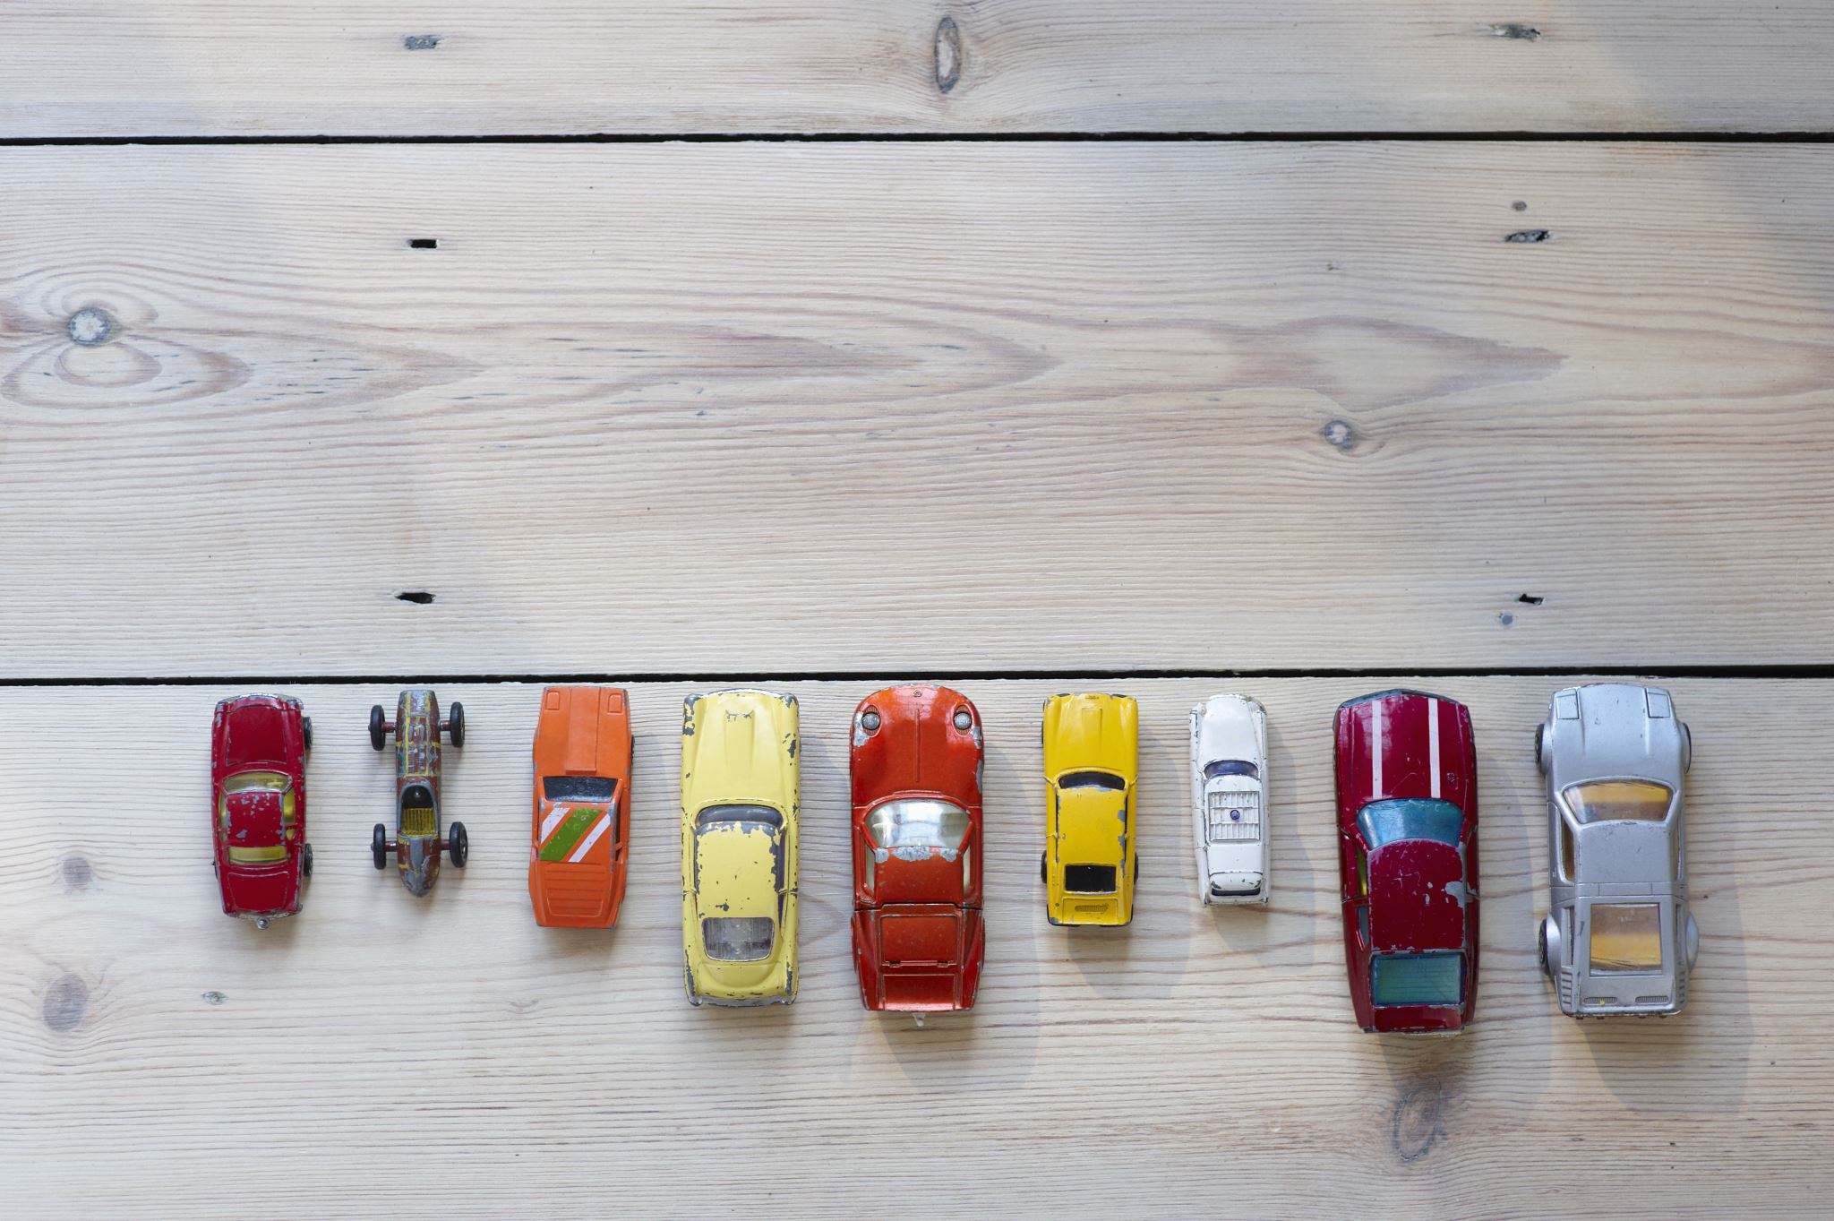
Australian Vehicle Trends - Data Visualization

Slide 2

Project Description
Looking at recent vehicle listing data in Australia, we aim to perform exploratory data analysis to determine relationships between different variables and find trends in vehicle sales.

Slide 3



Meet the team
Anrie Santos
Dominik F
Husna Nasution
Q1: How does car price vary by location and location average income?
Q2: How much does engine size (engine volume and number of cylinders) affect fuel consumptions?
Q3: What are the dominant vehicle brands and types in the Australian market?

Slide 4
Research Question
Q1: How does car price vary by location and location average income?
Datasets:
Australian Vehicle Prices https://www.kaggle.com/datasets/nelgiriyewithana/australian-vehicle-prices/code
Average weekly ordinary time earnings, full-time adults by state, original
Australia Geo Postcode https://gist.github.com/randomecho/5020859
Anrie Santos

Slide 5
Research Question
Q2: How much does engine size (engine volume and number of cylinders) affect fuel consumptions?
Datasets:
Australian Vehicle Prices https://www.kaggle.com/datasets/nelgiriyewithana/australian-vehicle-prices/code
Dominik F

Slide 6
Research Question
Q3: What are the dominant vehicle brands and types in the Australian market?
Datasets:
Australian Vehicle Prices https://www.kaggle.com/datasets/nelgiriyewithana/australian-vehicle-prices/code
Husna Nasution

Slide 7
Task
Q1: How does car price vary by location and location average income?
Tasks:
Cleaning the datasets
ABS
Aus Vehicle Prices
Postcode Geo
Aggregate the prices of all the cars grouped by Suburb (mean, mode, median, stderr, var, sem)
Merged the datasets from the Vehicle prices (aggregated) to the Postcode Geo
Anrie Santos

Slide 8
Task
Q2: How much does engine size (engine volume and number of cylinders) affect fuel consumptions?
Tasks:
Dominik F

Slide 9
Task
Q3: What are the dominant vehicle brands and types in the Australian market?
Tasks:
Husna Nasution

Slide 10
Data
Q1: How does car price vary by location and location average income?
Anrie Santos

Slide 11
Data
Q1: How does car price vary by location and location average income?
Anrie Santos

Slide 12
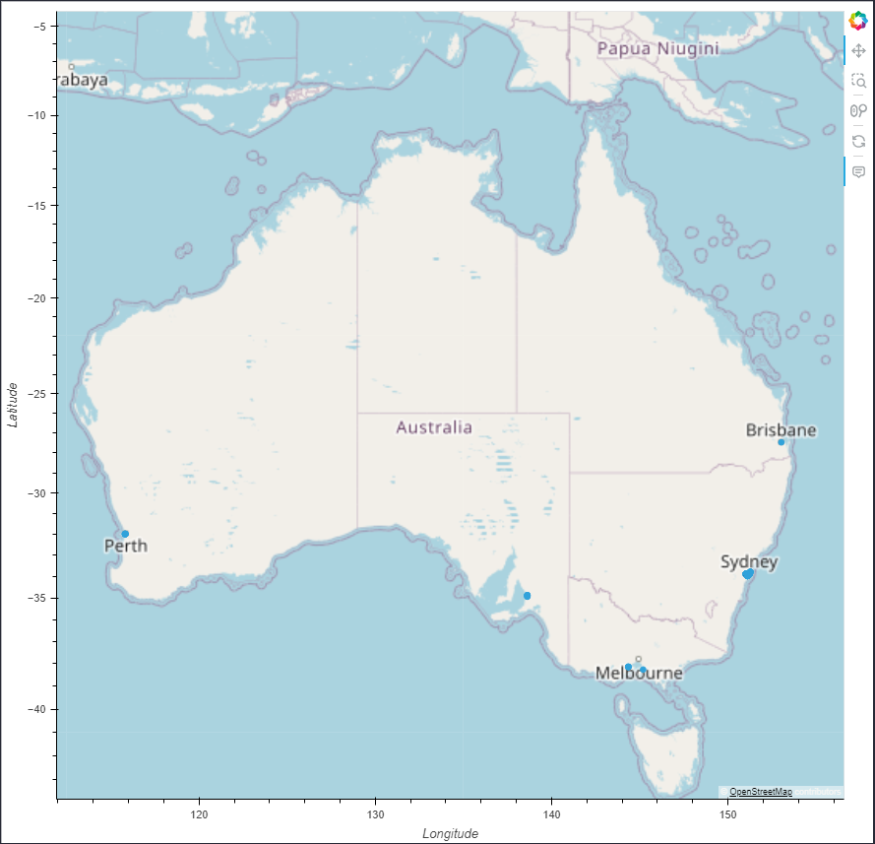
Findings
Q1: How does car price vary by location and location average income?
Findings:
Top 2 vehicle price by State are Tasmania and WA
Top 2 vehicle price by Suburb are Rushcutters Bay and Geelong West
Anrie Santos

Slide 13
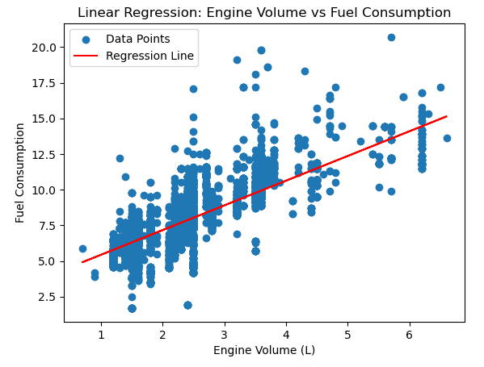
Q2: How much does engine size (engine volume and number of cylinders) affect fuel consumptions?
Data
Dominik F

Slide 14
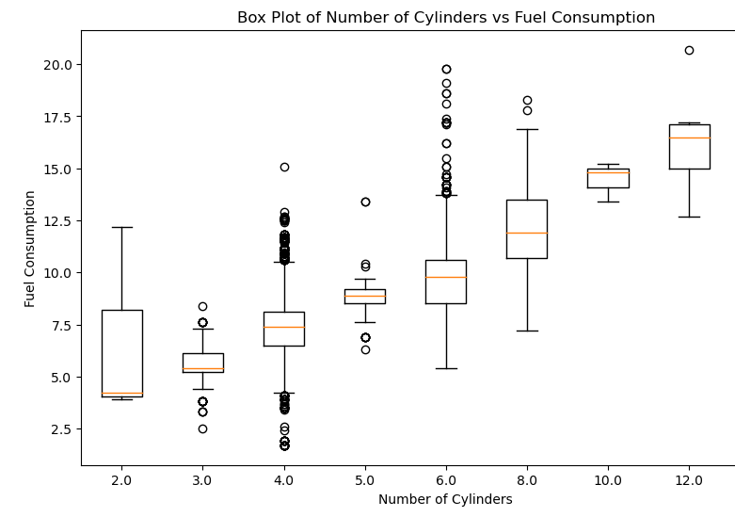
Q2: How much does engine size (engine volume and number of cylinders) affect fuel consumptions?
Findings
Dominik F

Slide 15
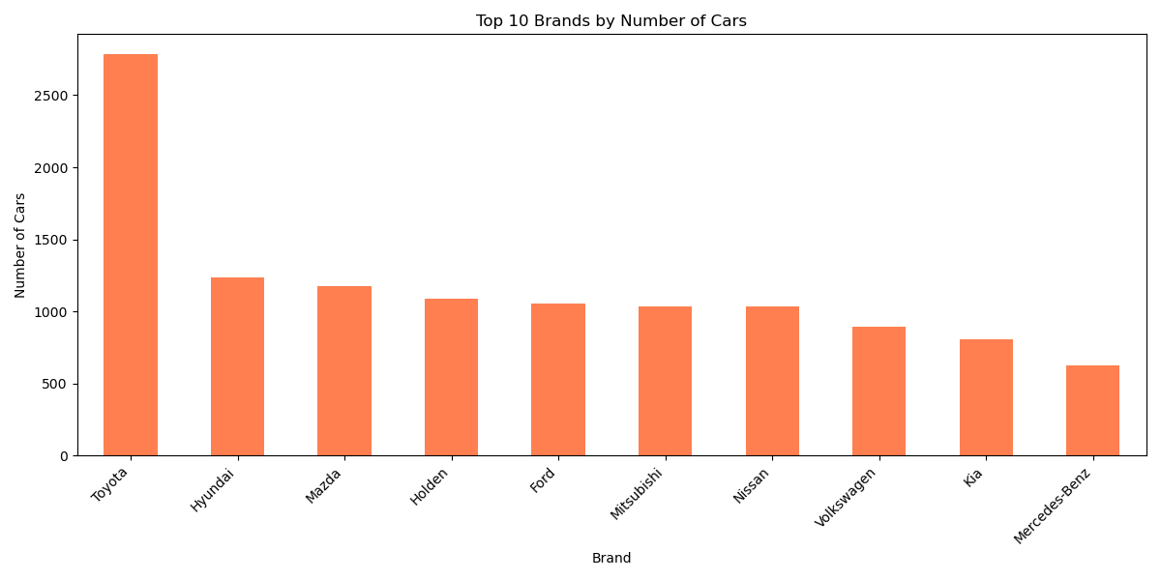
Q3: What are the dominant vehicle brands and types in the Australian market?
Data
Husna Nasution

Slide 16
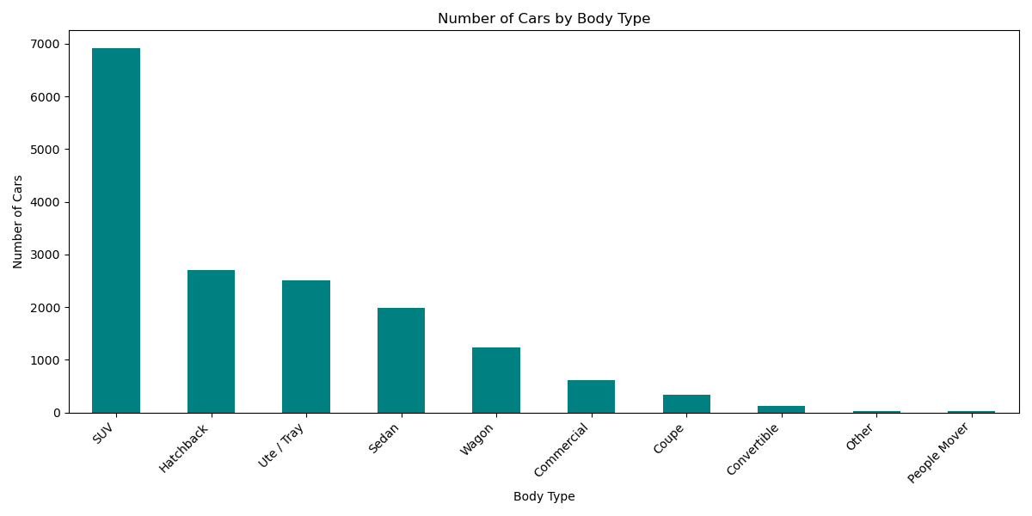
Q3: What are the dominant vehicle brands and types in the Australian market?
Data
Husna Nasution

Slide 17
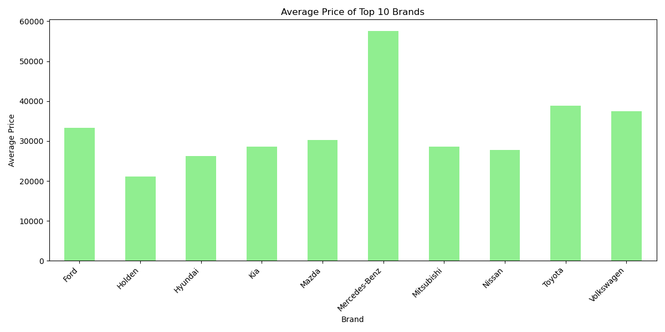
Q3: What are the dominant vehicle brands and types in the Australian market?
Data
Husna Nasution

Slide 18
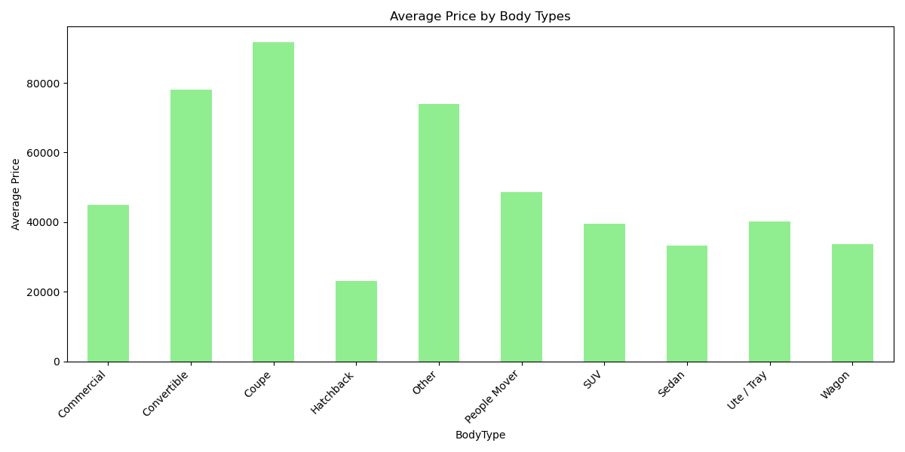
Q3: What are the dominant vehicle brands and types in the Australian market?
Findings
Husna Nasution

Slide 19
Conclusion
The findings from this dataset are the recent vehicle listing data in Australia. Our aim to perform exploratory data analysis to determine relationships between different variables and find trends in vehicle sales, location and engine size by fuel consumption has been discussed in this presentation. From our findings, the suburb with the highest average vehicle price are Rushcutters Bay and Geelong West. The states with the highest average vehicle prices are Tasmania and Western Australia.

Slide 20
Thank you

